Slide 1

Carbohydrate Counting Session
OBJECTIVES: By the end of this session you will be able to:
AIM: Is that you should be able to say which foods that you need to count the carbs in and which foods you don’t.
Identify the 3 different types of carbohydrates and their effect on blood glucose
Identify carbohydrate foods that you need to count
Identify foods that contain carbohydrates and those foods that do not
Read and understand food labels
Be able to carb count your food at high school

Slide 2
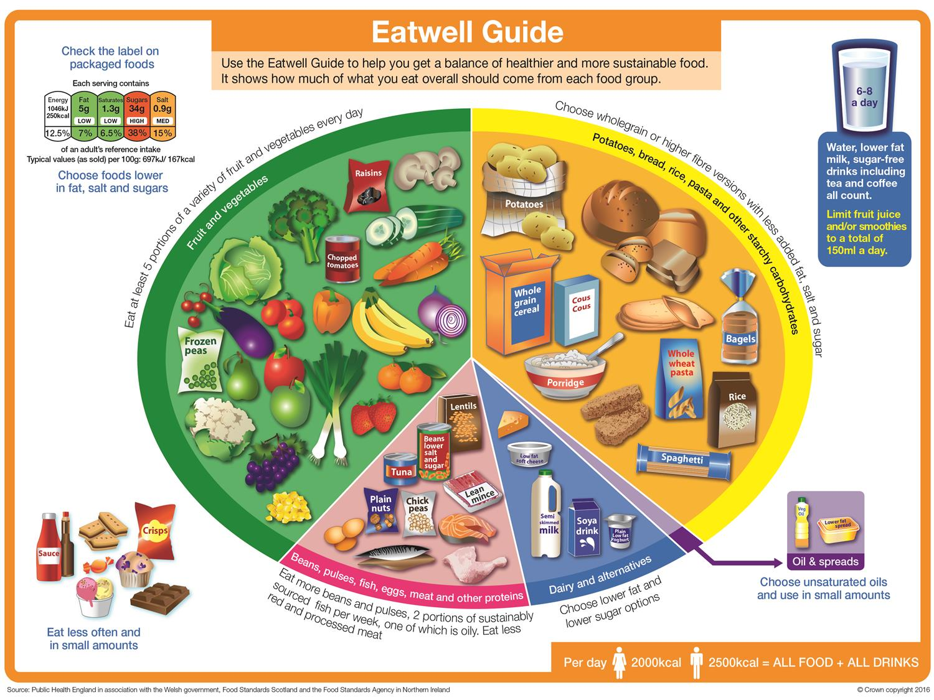
Notes:
The Eat Well Plate encourages you to choose different foods from the five groups every day, to help ensure you obtain the wide range of nutrients your body needs to remain healthy.
Choosing a variety of foods from within each group will add to the range of nutrients you eat. No single food contains all the nutrients needed for health so we should try to eat a balanced diet.
By choosing a variety of foods from the five food groups, most people will get all the nutrients they need to stay healthy and active.
(Click/return to transition to next slide).

Slide 3
Carbohydrates vs Non carbohydrates
Carbohydrates – need insulin
Bread and bread products, fruit breads
Pasta’s
Rice, cous cous
Noodles
Sweets, choc, biscuits, ice cream etc
Potatoes and potato products
Breakfast cereals
Baked beans
Quiches, pies, pastries
Pasta, curry and stir fry jars
Pizza, fishfingers, nuggets etc
No carbohydrates (no insulin)
Eggs
Meat & chicken (non coated)
Fish (non coated)
Mayonnaise
Cream
Cheeses
Butter & spreads
Sugar free drinks and foods, eg jelly
Low carbohydrates (no insulin)
Salad
Vegetables
Nuts

Slide 4

Starches: bread, rice, pasta, noodles, potatoes, breakfast cereals, crackers, beans, flour & flour products
Carbohydrate foods
Starches:
bread, rice, pasta, noodles, potatoes, breakfast cereals, crackers, beans, flour & flour products
Natural sugars:
fructose = fruit & fruit juices
lactose = milk & yoghurts
Added Sugars: glucose, sucrose, maltose, dextrose
Fizzy drinks, biscuits, cakes, sweets & chocolate

Slide 5
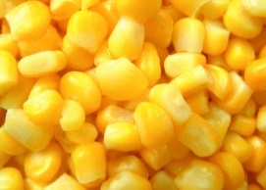
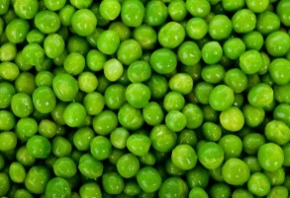
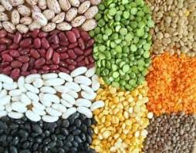
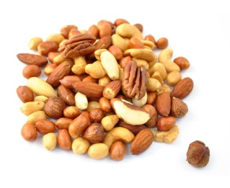
Carbohydrates that do not need to be Carb Counted
As a general rule, the high level of fibre, protein and fat (nuts) in these foods mean that they are slowly digested. This means that a normal sized portion of these foods probably won’t affect blood glucose levels enough to need rapid acting insulin - your background insulin should be enough to deal with the glucose released into the bloodstream. Large portions may raise blood glucose. Please check how these foods affect your blood glucose
Please note:
Nuts should not be sugar-coated
Sweetcorn and peas - fresh, frozen or tinned in water that doesn’t contain sugar
Sweetcorn – high in fibre
Peas – high in fibre
Beans and pulses – high fibre and protein
Nuts – high fibre, protein and good fats

Slide 6
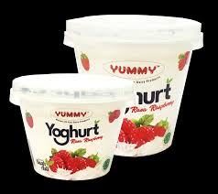
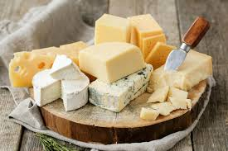

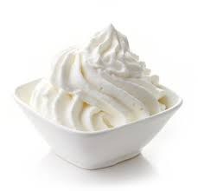
Carbs in Milk and Dairy Foods- which do you count?
MILK
WATERY PART
CONTAINS CARBOHYDRATE
(ie lactose)
LOW FAT
FATTY PART
LOW CARBOHYDRATE (ie low lactose)
HIGH FAT
CREAM
CHEESE – hard cheeses, cream cheese, cottage cheese
MILK
YOGHURT (including yoghurt drinks)
CARB COUNT?
YES
CARB COUNT?
NO

Slide 7
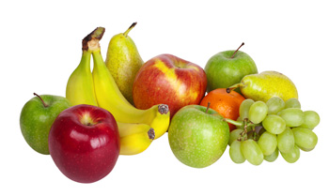
Fruit
Fruit contains the natural sugar FRUCTOSE
Fruit eaten as part of a meal should always be carb counted
Contains fibre which slows the absorption of glucose into the blood
A small portion of fruit that contains 10g carbs may be eaten in between meals and should not need carb counting – check BG
Patients with pumps should carb count all fruit (meals and snacks)
Fruit juice, smoothies and processed fruit snacks are not recommended because the NATURAL sugar and the processing/liquidising of this fruit means that it will be digested quicker and cause a spike in BG - It is better to eat a whole piece of fruit.

Slide 8
Foods that DO NOT need to be carb counted
Eggs
Meat – lamb, beef, pork, chicken (uncoated with batter or breadcrumbs)
Tinned tuna, mackerel, sardines, crab sticks etc
Vegetables
Salad
Mayonnaise
Sugar free jelly
Sugar free fizzy drinks and cordials
Butter and spread
Cooking oils
Cream
Cheese ( including cream cheese and cottage cheese)
Salsa, olives, pickled onions/gherkins etc
Nuts
Sugar free nut butters
Meridian chocolate spread – (small amount)
Casseroles containing just veg and meat (no potatoes)
Stir fries from scratch– just meat and veg
Curries from scratch - just meat and veg

Slide 9
Carbohydrate counting
Try not to guess the amount of carbs in your food/meals because it is easy to over or under estimate and you will end up giving the wrong dose of insulin resulting in a high BG or a hypo.
There are 3 ways to carb count:
1) Picture matching from your carbs & cals book or app
This method is useful when you are eating out or do not want to use the other methods
2) From the food label
Useful when you purchase food when you are out and about or for ready meals
Watch this video for help:
https://www.youtube.com/watch?v=hZFER_jhTwU
3) Calculating the carbs in 1g food and weighing your portion The most useful when you are cooking meals from scratch at home
Watch this video for help:
https://www.youtube.com/watch?v=Xp3CK6nExqQ

Slide 10
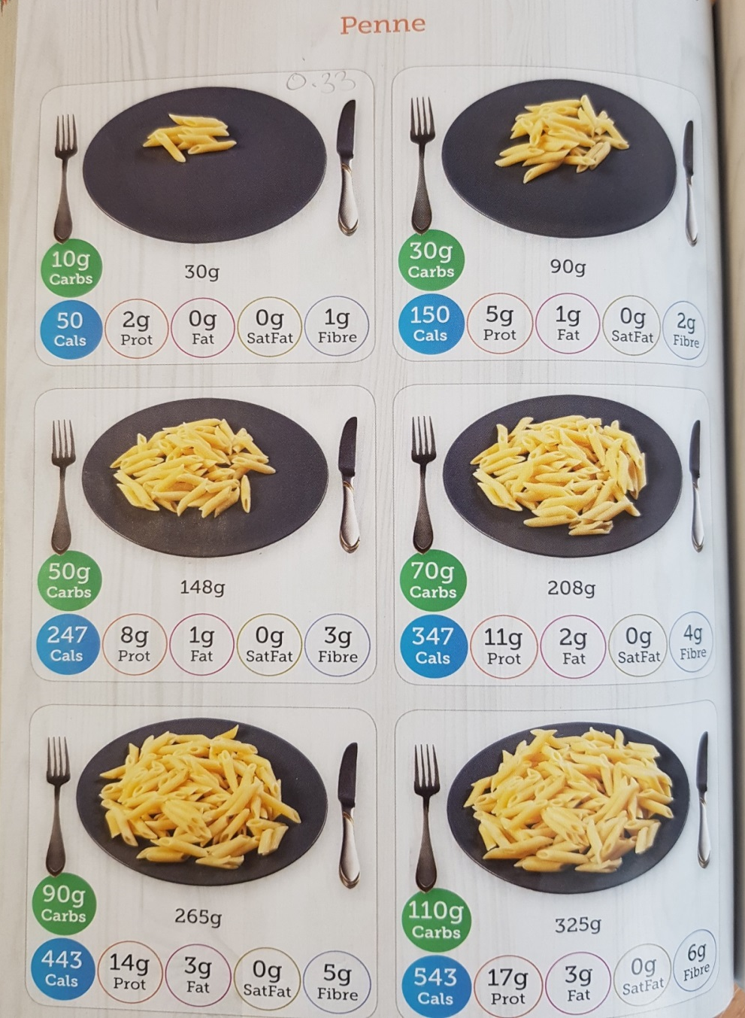
Carb counting by picture matching
This could be compared to a ‘fist’ size portion of pasta. 1 ‘fist’ = 30g carbs
When you picture match, you can choose the portion size you want and look at the carbs in the green disc, eg 148g portion of pasta has 50g carbohydrate.
Or, you can gauge the portion by eye if you are eating out – so this portion would have just under 2 ‘fists’ of pasta (see handy measures slide coming up next)
or
you can weigh the portion if you are at home

Slide 11
Handy Measures
Try and compare food portions to a shape to help you when you are unable to weigh the food, for example:
Egg sized potato = 10g carbs
Hand with fingers together = pizza slice = 30g carbs
Fist of hand sized jacket potato = 40g (see carbs & cals book)
Fist of hand sized portion of pasta = 30g (see carbs & cals book)
Digestive biscuit size of pastry= 10 g carbs
You would then visualise how many ‘fists’ of pasta are on your plate and you can estimate how many carbs are in that food

Slide 12
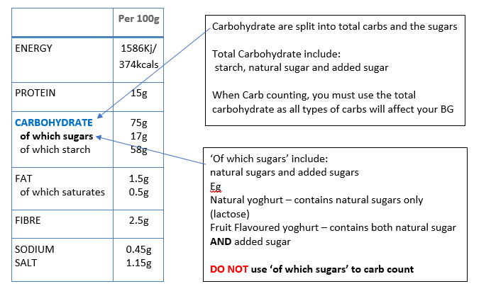
Understanding Nutritional Information

Slide 13
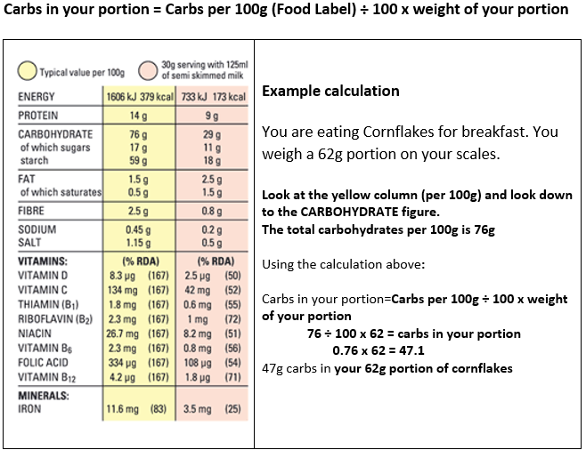
How to carb count from a Food Label

Slide 14
How to carb count from a Food Label
Look at the serving size when calculating carbohydrates.
A manufacturer’s definition of a portion or serving size may be different from your child’s. Portion sizes given are suitable for adults over the age of 18.
Younger children and teenagers may need different amounts.
You can work out the amount of carbohydrate in your (or your child’s) portion by weighing their food portion and comparing the amount to how many carbohydrates there are in 100g of that food portion.
Remember:
Food labels usually give the carbs of the dry weight of these foods. As these foods absorb water when cooked, the carb content of the dried weight will be different to the carb content of the cooked weight.
So, if you are carb counting cooked foods like paste, rice, noodles, cous cous etc, always use the carbs and cals book (or app) as this shows the carb values for cooked food.
For more help, watch this video: https://www.youtube.com/watch?v=hZFER_jhTwU

Slide 15

How to calculate how many carbs are in 1g of different foods from carbs and cals book/app
          Use the top left picture for foods that show more than 1 portion size (you do not need to calculate every picture).
The calculation is:
carbohydrate (g) ÷ weight of portion(g)
or
{green carbs disc ÷ white portion weight}
So, 10 ÷ 33 = 0.33g carbs in 1g pasta
The number should always be less than 1 and will never change. The only thing to change is your portion size. Watch the following video for more help:
https://www.youtube.com/watch?v=Xp3CK6nExqQ

Slide 16
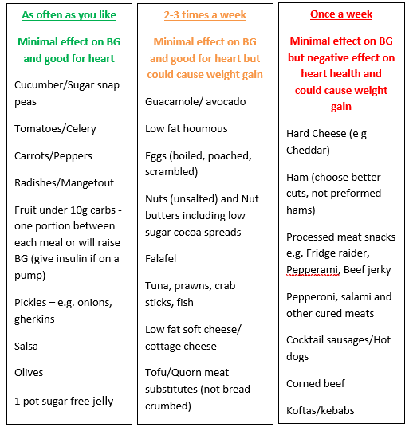
Snacks that do not need insulin

Slide 17
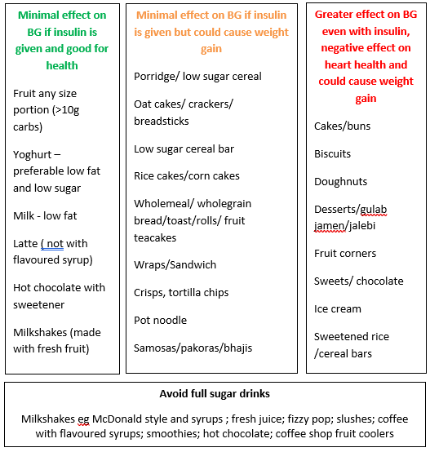
Snacks that need insulin

Slide 18
Practical carb counting in school
The dietitians will cover the practical issues around carb counting food at high school
Any questions please contact the Dietetic Team on 01254 732463

