Slide 1

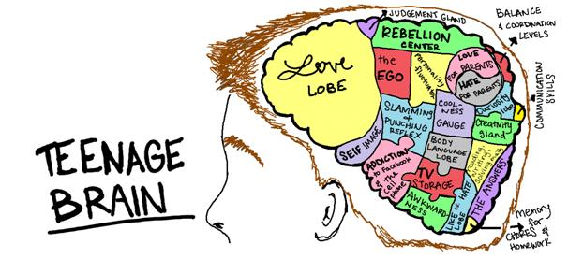
What to Expect When You’re Expecting a Teenager
Laura Nicholson,
Clinical Psychologist in the Diabetes team

Slide 2


Session Focus
Common challenges in adolescence
Strategies to help minimise difficulties
Nb: Don’t panic!!
Not all teenagers experience all (or any!) of these issues!

Slide 3
Biological issues
Hormones (and impact on mood)
Body changes → impact on self-identity
May start to look like (and be treated like) an adult
Emerging sexuality
Increasing sense of gender identity
Puberty & impact on body image
Growth spurts -> clumsiness, embarrassment, etc
Brain changes
Social issues
Friendship changes
Romantic/sexual relationships
Many new situations, often without direct parental support for first time
Challenging boundaries with exploratory/risky behaviours e.g. smoking, drug/alcohol use
Aim to develop increased independence
Social media (inc. comparison to others)
Exams and school pressure
Increased awareness of culture/society & their place within this
Increased independence & responsibility (? without the skills necessary to manage this)
Psychological issues
Developing sense of self – self-identity, self-esteem, self-image, etc
Switch from mainly concrete thinking (early adolescence) to potential for abstract thinking (middle adolescence)
Response and adjustment to all of the biological and social issues identified!!!

Slide 4
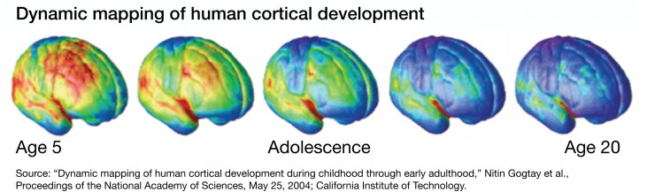
Teenage Brains
Human brains continue developing until age 25
In adolescence:
The parts responsible for thinking, planning and inhibition are under-developed
The “emotional brain” is relatively over-developed → increased sensitivity to the rewards of risk-taking
Together, this leads to:
Difficulties with reasoned thinking – including anticipating the consequences of actions, and taking others’ perspectives into account
Difficulties inhibiting urges
Increased likelihood of behaving impulsively, emotionally and on ‘gut’ reactions
Increased likelihood of “risky” behaviours – “bullet-proof self” (can’t appreciate risks to self)
Notes:
4

Slide 5





Online Safety
Be aware of their online activity (who they’re talking to, what info is being shared etc) – ideally with access to their accounts
Speak to them about the importance of online safety – e.g. only sharing things (even “privately” – e.g. via text/snapchat) that they’d be happy for everyone to see
Be aware of length of time spent online and any impact on mood
Risks through social media of comparisons to others and potential low self-esteem, low mood etc
Further advice available at www.nspcc.org.uk/preventing-abuse/keeping-children-safe/online-safety/ - including advice re social media, apps, gaming, parental controls and sharing info.
Also free phone advice line - 0808 800 5002

Slide 6


What helps? – In general
Strategies to use all of the time:
Remember the challenges of adolescence, and keep expectations in line with these (e.g. expect them to need support with planning & prep; accept they are unlikely to be motivated by long-term consequences – focus on short-term)
Model the behaviours you want to see where possible
Spend time with your child, NOT focusing on diabetes or other difficulties
  Activities/conversation ideally led by the young person and their interests
  Ideally offer on a daily basis (even just 10 minutes)
  Continue to offer, even if not accepted
Decide WITH your child who will monitor their diabetes and how
Ask about the person first, NOT the diabetes
Make boundaries & expectations clear
(including any changes) and provide reasons
Problem-solve with the young person
(rather than just telling them what to do)

Slide 7
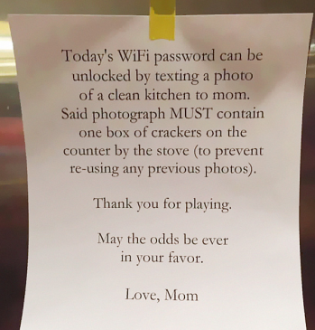
What helps? – With challenges
Extra strategies to use (in addition to those on previous slide) when difficulties occur:
Give attention to behaviours you want to see MORE of (e.g. doing a BG check at the right time) rather than focusing on when this is not done
Give specific, labelled praise for desired behaviours e.g. ‘Well done for giving your insulin before you eat’
Consider rewards for desired behaviours which the YP is struggling with
Where possible ignore behaviours you want to see less of
Have consequences for unacceptable behaviour – identify realistic options in advance; make these clear to the YP; follow through with them!
If thinking about consequences (e.g. of not giving insulin) aim to focus on short-term effects (as unlikely to be able to fully appreciate long-term risks) and on things that matter to the YP.

Slide 8
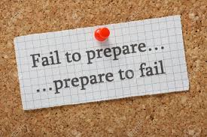
What helps? - Shifting responsibility
Think about the BALANCE in responsibility for diabetes management - keep reviewing this with YP over time to identify if/when changes need to be made, and decide together what the next step should be and when this should happen.
Aim for GRADUAL shifts in responsibility over time, ideally broken into smaller steps
    E.g. Identify any extra responsibilities the YP will have for diabetes management in secondary school; are they currently capable, willing and ready? If not, how can we support them with this until they are?
Include advance PLANNING and PREPARATION for each new step
Acknowledge the potential challenge for you of handing over responsibility after working hard to follow recommended diabetes guidelines
  What is reasonable to expect of the YP? What is realistic? Is extra support needed to help them achieve this?
  How will you respond if diabetes care dips? What would be helpful to the YP?

Slide 9



Key points
Being a teenager can be confusing and challenging –
try to remain patient and kind
Parenting a teenager can also be confusing and challenging –
try to be patient and kind to yourselves!
Have realistic expectations: Some challenges are to be expected during adolescence; pick your battles.
Keep the faith: Adolescence will end!!
Let us know if things are becoming more difficult and
you think that extra support or other changes could help.

Slide 10

Thanks for listening!
Please email any questions to kidsdiabetes@elht.nhs.uk
and I will (try to!) answer them in the follow-up session.

