Slide 1
Moving up to high school

Slide 2
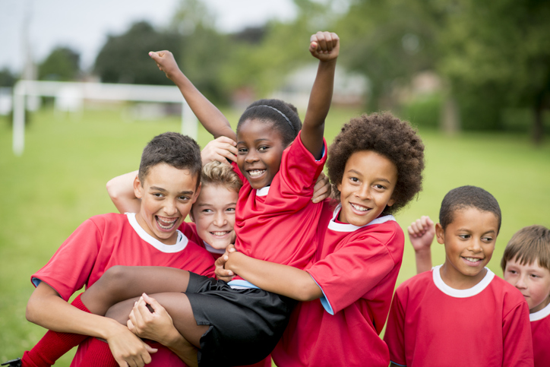
Excitement/worries

Slide 3
Video
https://www.cypdiabetesnetwork.nhs.uk/news/starting-secondary-school-with-type-1-diabetes-short-video/

Slide 5
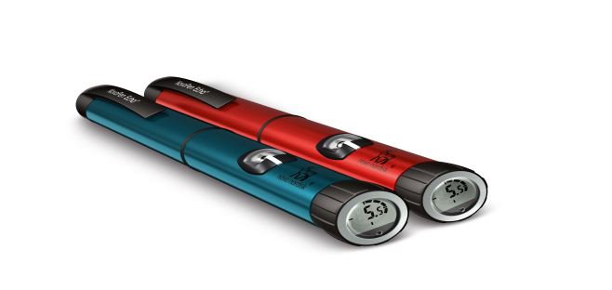
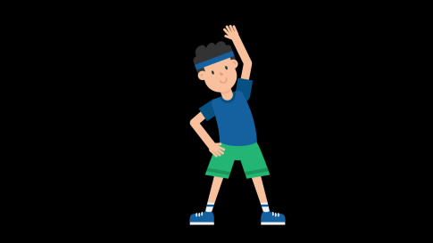
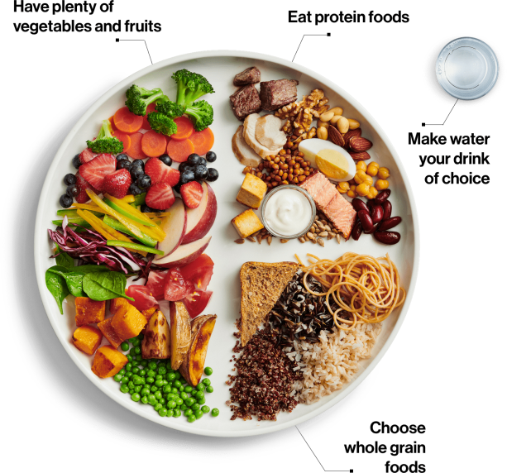
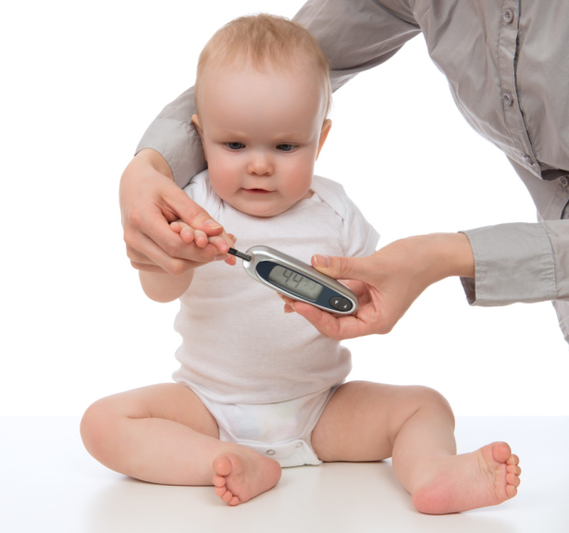
Goals of education
Diabetes

Slide 6
Goals of education
https://www.novonordisk.co.uk/content/dam/UK/AFFILIATE/www-novonordisk-co-uk/Home/Health%20Care%20Professionals/Documents/BC_3935_NN_With%20You%20All%20The%20Way%20-%20Goals%20of%20diabetes%20education%20-%20Digital%2010-11_V3_FINAL.pdf

Slide 7
Deapp

Slide 8
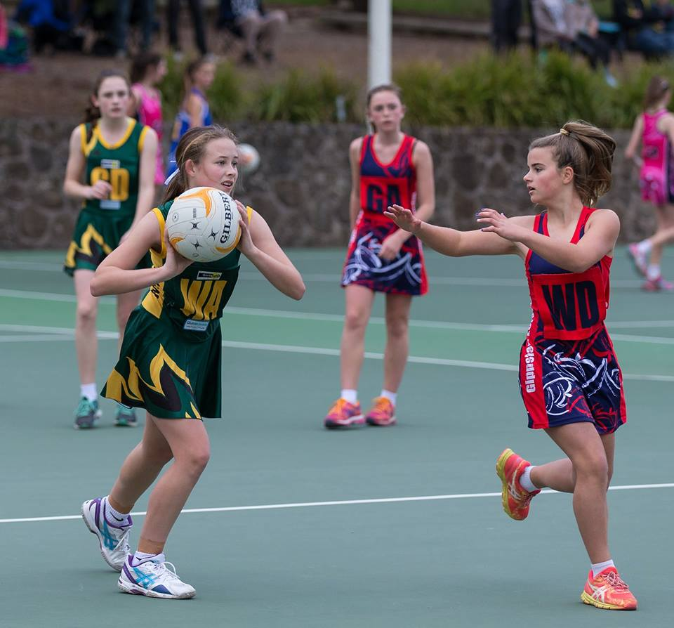
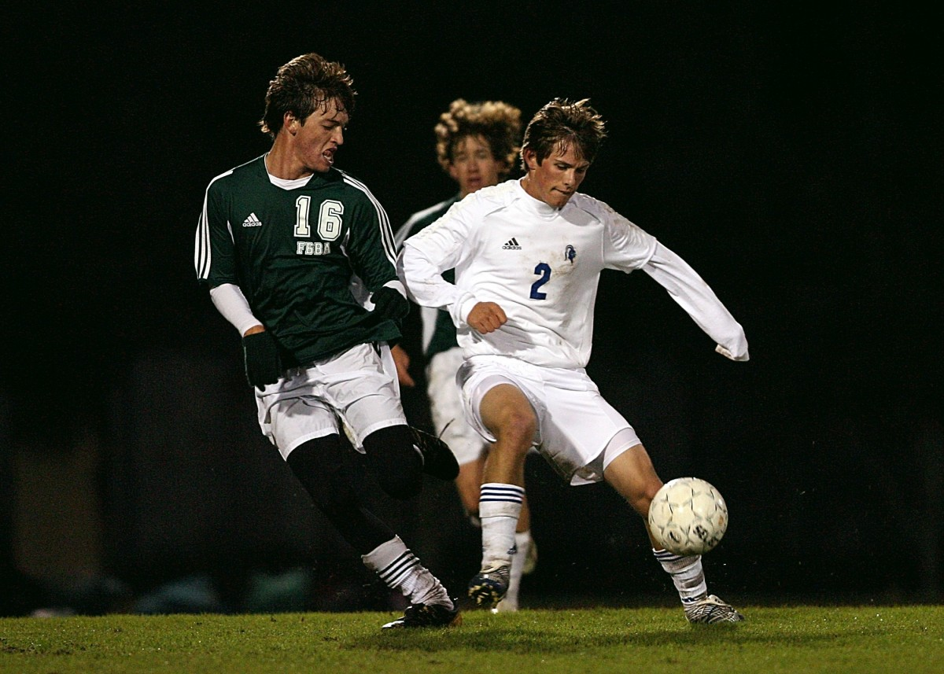
Exercise and Activity

Slide 9
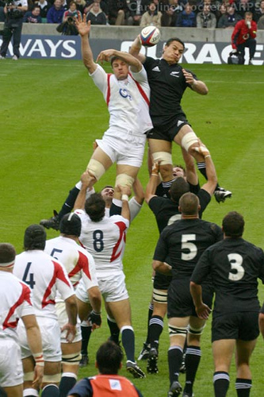
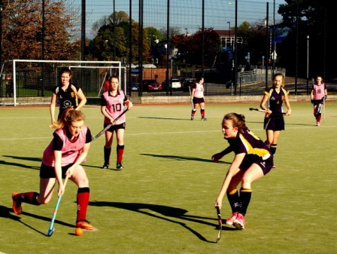
How activity is it going to be different in High school?
Different activities
Higher intensity for longer
Clubs at lunch/
after school
Activity is away
from main building
Looking after own
diabetes kit

Slide 10
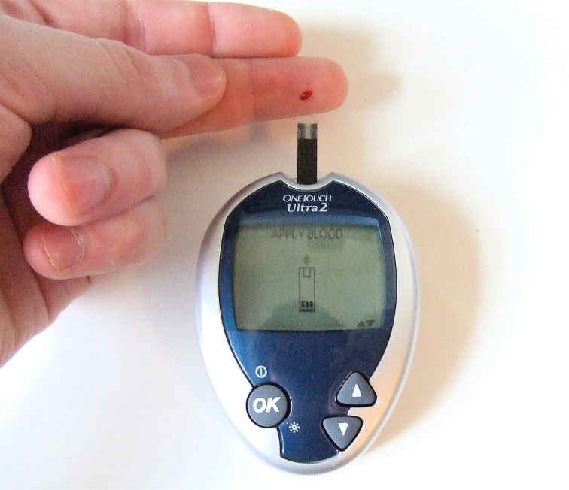
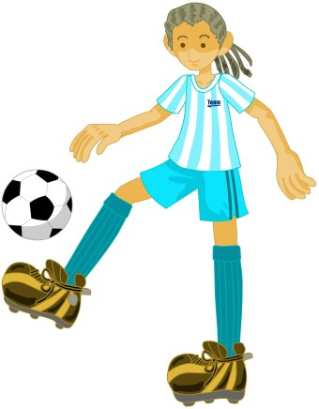
Changes in BG with different activities
Are you competitive?
Activities that raise BG
Activities that drop BG
Find out how your body
reacts to different activities

Slide 11
Type of activity and BG

Slide 12
Anaerobic vs Aerobic Activities

Slide 13
What do you need for activity?
BG checking and hypo kit
Check BG-before and after and maybe during (if new activity)
Time of day(just after/just before meal)
Type of activity, intensity and for how long
How you react to different activities: BG goes up or down

Slide 14
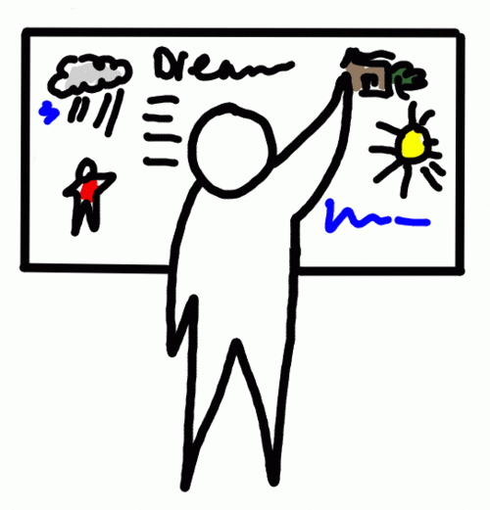
Make a plan at home
What activities you do for how long and when
How these activities
affect your BG
What you can do
to keep BG on
target

Slide 15
What you can do to manage BG
If your BG goes down with the activity:
Reduce insulin at meal before activity(if activity is in less than 2 hours after you eat) OR
15g carb snack before activity if BG less than 7mmol
If your BG goes up with the activity:
Give half of suggested correction at meal after activity

Slide 16
Example of a Plan
Activity | For how long | How affects BG | When doing it | Plan
Football | 1 hour | Drops | 11am | If BG less 7-have extra 15g carbs
High intensity interval training | 30 mins | Increases | 10am | Give half of suggested correction at lunch
Cross country | 1 hour | Drops | 9am | Reduce insulin at breakfast by 10-20% (1-2 units)
Lunchtime gym | 30 mins | Don’t know, never done it | 12.30 | If BG less 7-have extra 15g carbs and reflect

Slide 17
Activity when on an insulin pump
Activity is often associated with the need for less insulin, and therefore if on a pump, the option to decrease the basal rate is useful
Things to think about:
• will you need to take your pump off to participate in the activity?
• if you are wearing the pump, will you reduce your basal rate during the activity?
• will you reduced your basal rate after the activity, and how long for?
• will you have an extra activity snack, or can BG be managed by reducing your insulin dose with the meal before?
Adjusting insulin for activity is often a process of trial and error, as each individual reacts differently

Slide 18
Some suggested insulin dose adjustments with Activities

Slide 19
Any questions? Email us on kidsdiabetes@elht.nhs.uk

